Slide 1


PACEdge 2.3
Technical Training
20.09.2023

Slide 2
PACEdge 2.3- Technical Training Agenda
 | Introduction to the PACEdge Platform
 | PACEdge Architecture Overview
 | PACEdge Performance Indication
 | PACEdge Getting Started and basic How To
 | Licensing and Other PACEdge Utilities
 | New Features in PACEdge v2.3.0 ! (Group Manager, Certificate Management, etc)
Notes:
Changing the color bars in the agenda table works the same as changing them in the side bar tables.
Click in the space to the right (or left) of the bar
Then go to the Design tab under the Table Tools
Change your Pen Weight to be 6pt
Select the color you would like to change it to
Then click the down arrow under Borders and select right or left border (depending on which side you clicked in originally…)

Slide 3

PACEdge is an IIoT Application Enablement Platform for the development of scalable data intensive Industry 4.0 solutions requiring integration between the OT and IT domains without disrupting OT assets, architectures or systems while satisfying IT cybersecurity, communications and application requirements.
Notes:
To replace the photo:
Select the transparent gradient overlay right click, choose Arrange > Send to Back
Select the photo and press delete on your keyboard
From the Insert menu, choose Insert Photo > Picture from File
Crop and resize photo to fill slide (hold down Shift key while resizing to maintain picture aspect ratio)
Select the photo, right click, choose Arrange > Send to Back so the photo is behind the gradient
To edit text:
Click inside a text box, scroll over (with your mouse) to select all text and begin typing

Slide 4









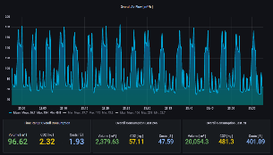








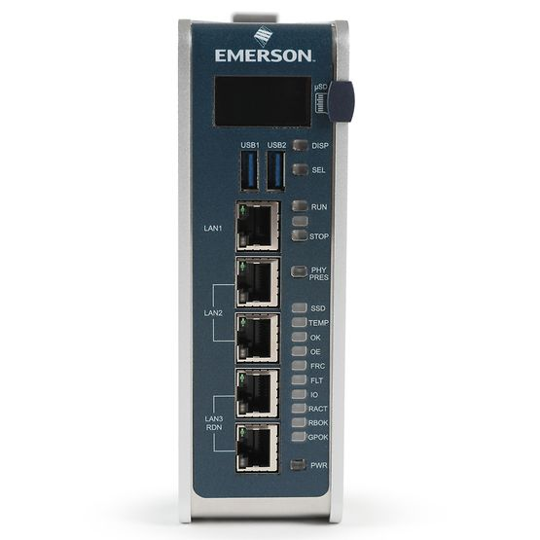
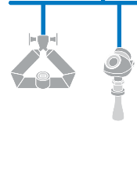
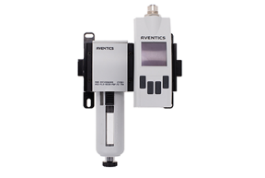
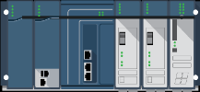

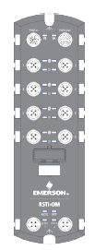

PACEdge and Movicon Software Suites
CLOUD / ENTERPRISE LEVEL
Edge &
Computing
Supervisory
Layer
Data Aggregation, Analytics, Visualization, Modeling
PACEdge
MOVICON
HMI/SCADA
MOVICON PRO.LEAN / PRO.ENERGY
PLANT LEVEL
FIELD / MACHINE LEVEL
RX3i CPL4XX
Edge Control
Notes:
Resolution: Introducing PACSystems Edge Solutions

Slide 5

PACEdge Supports The Unique Needs Of Use Cases and Applications That Lie At The Intersection Of OT & IT Systems
OT Protocols
SCADA
Cloud
Historians
IT Integration
Enterprise
Industrial PC
Machines
Cybersecurity
Servers
HMI
AI/ML Execution
Data Lake
Controllers
Contextualization
Visualization
Analytics
Sensors
Processing & Analytics
Robotics
AI/ML Model
OT Systems
IT Systems
PACEdge
At The Intersection of OT & IT Lie Features And Functionality Unique To Use Cases And Applications Such As AI/ML Execution For Quality Analysis, Edge-to-Enterprise Processing For Energy Management And Remote Monitoring For Equipment Maintenance
Notes:
To edit text:
Click inside a text box, scroll over (with your mouse) to select all text and begin typing
To remove primary information tabs:
Select and delete unwanted tabs – recommend starting at the bottom
To add primary information tabs:
Select and group all existing tabs
Resize the group to create space for additional tabs and ungroup
Select the bottom tab and CTRL-Shift-Drag to make an aligned copy (or copies)
Distribute the tabs using the Arrange button on the Home tab and the Distribute command

Slide 6



The Value Of PACEdge Is In It’s Powerful Easy-to-Use Development Environment Supported Throughout The Life Of The Application
Easy-to-Use
Powerful
Supported
Graphical Development Environment
Intuitive User Interface
Built-In Tooling & Platform Services
Modern Data & Machine Visualization
Communicates With 30+ Protocols
On-board Data Storage & Processing
AI/ML execution environment
Fully Integrated & Validated Releases
Timely Security & Defect Resolution
Continuously Enhanced Features
Notes:
To replace the icons:
Select an icon to use from the back of this deck or another source and copy it to the slide
Size the replacement icon to match the existing icon
Select the original icon, right click, choose Arrange > Bring to Front so the old icon is in front
Align the new icon to the existing icon using the Arrange button on the Home tab and the Align or Distribute commands
Delete the original icon
To edit text:
Click inside a text box, scroll over (with your mouse) to select all text and begin typing
To remove an icon and primary/secondary information text set:
Select a set and delete
Group each remaining set and arrange on the slide using the Arrange button on the Home tab and the Align and Distribute commands
To add an icon and primary/secondary information text set:
Resize the elements to make room if required
Group each set
Select a set and CTRL-Shift-Drag to make an aligned copy
Adjust the color of the new copy
Arrange the grouped sets on the slide using the Arrange button on the Home tab and the Align and Distribute commands

Slide 7



Tiered Software Offerings
NEW !
+ Group Manager
Group
Manager
+ WebHMI Visualization
FUNCTIONAL TIERS
+ Support for proprietary communication protocols and high quality OPC UA Server
PACEdge platform, including Open Standard communication protocols, data storage, analytics and visualization
TARGET APPLICATION / USE CASES

Slide 8
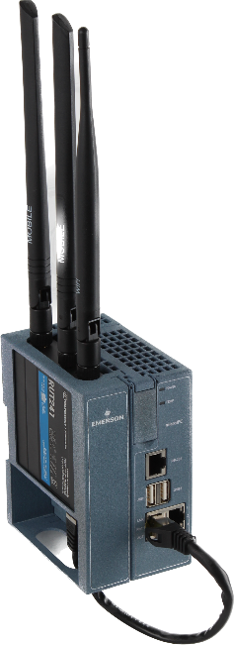
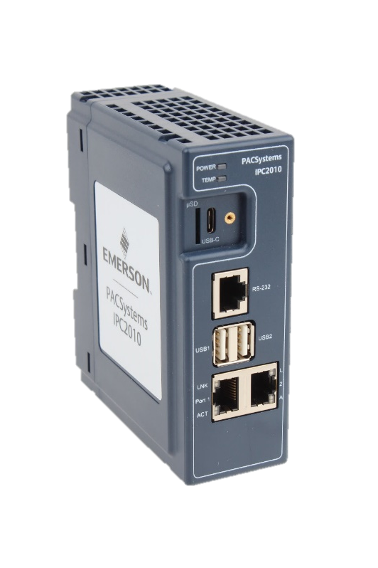


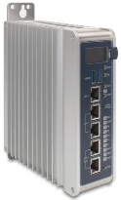
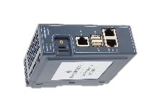
HW Options
New HW
Controller
Web HMI
Controller
Web HMI
Connext
Connext
Connext
Connext
Edge Core
Edge Core
Edge Core
Edge Core
Edge Core
Starting with PACEdge v2.3.0 IPC2010 is supported
IPC2010 key specs:
  2x ARM A53 cores at 1.2GHz
  2GByte RAM
  64GB SSD
  2x Gigabit Ethernet
  2x USB 2.0
  1x uSD
  1x RS232 Serial
  Optional WiFi/Cellular Module (add-on)
IPC 2010
RXi2-LP
RXi2-BP
IPC 2010
RXi2-LP
RXi2-BP
IPC 2010
RXi2-BP
CPE400
CPL410

Slide 9
PACEdge Technical Architecture
PACEdge Technical Architecture

Slide 10

















PACEdge 2.3.0 Application Enablement Platform Components
OPEN interoperable Edge intelligence
Group Manager
Application Enablement Platform
WEBHMI & GRAFANA
APPS
HMI & DASHBOARD
NODE-RED
LOGIC &
FLOW CONTROL
APPS
Mqtt broker
Cockpit
MYSQL & INFLUXDB
I/O DATA SERVER
DATA
STORAGE
APPS
PORTAINER.io
App Management
APPS
CONNEXT & MOSQUITTO
IT/OT DEVICE
INTEGRATION
Linux
Linux
Optimizing Edge-to-Cloud Controls
Emerson Confidential
10

Slide 11
PACEdge is a Platform
Set of pre-integrated software tools, geared towards: Data logic, analytics, communication, database, visualization
Browser Based Graphical User Interface
Based on standard Linux OS
HW independent (runs on x86, ARM, VMs)
Typical use case: Headless PACEdge device, controlled from any PC with web browser or remote ssh session for configuration and debug

Slide 12
PACEdge is based on Dockers
Docker Container is just a “process” running in Linux
Containers reuse same Linux Kernel, but each has its own File System, binaries, libraries
Containers are isolated from each other and from the host OS !!
Containers are much lighter weight than Virtual Machines are, hence, less memory, less storage, faster to come up and to shutdown
Communication Container-Container, Container-Host is via network interfaces (REST API, MQTT, etc)
Docker Containers v.s. Virtual Machines

Slide 13
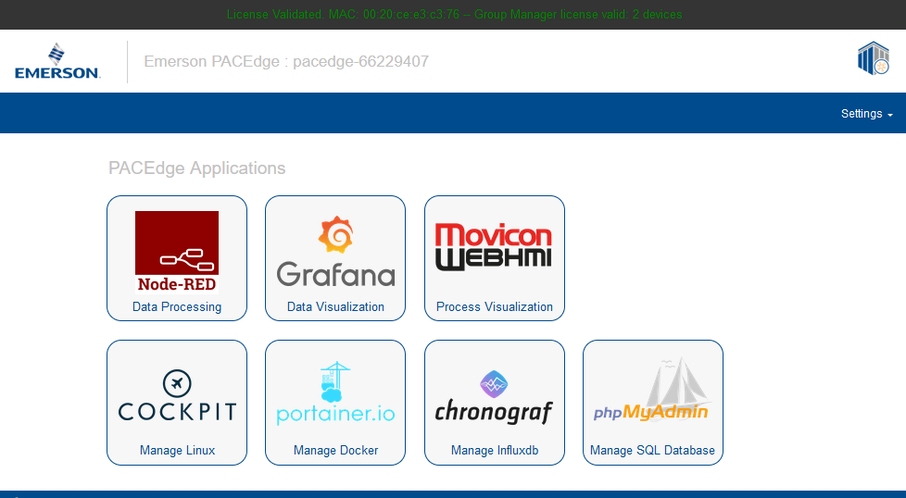
PACEdge Cyber Security
Applications are segregated from each other using Containers
Most network ports are closed for security reasons
Specific applications (Node-RED, Grafana, Connext, WebHMI, Portainer) are accessed via Traefik (proxy)
Internal network between containers is not accessible from the outside
Two instances of MQTT Broker:
  Internal: container to container communication
  External: open port for external communication
External communications encrypted using TLS
UEFI firmware protected via Secure Flash and supports Secure Boot technology
User roles, each with different privileges and password
Cyber security penetration tested by an external security team
More details in the PACEdge Secure Deployment Guide

Slide 14
Data Communication Model:
Southbound - Northbound data flow
From data flow perspective, Data:
Is being gathered from sensors, PLCs and other field devices (Southbound)
Is Processed
Is visualized via dashboards and WebHMI on the Edge unit
Is sent out to Enterprise, SCADA, Cloud (Northbound)

Slide 15
PACEdge:
Platform with Many Options
From data flow perspective, Data:
Is being gathered from sensors, PLCs and other field devices (Southbound)
  Requires variety of field busses and protocols, some proprietary to specific vendors
  Connext is well positioned for this connectivity
Is Processed and Stored
  Node RED, Python, Telegraf, databases
Is visualized via dashboards and WebHMI on the Edge unit
  WebHMI, Grafana, Node RED Dashboard
Is sent out to Enterprise, SCADA, Cloud (Northbound)
  OPC UA Server, MQTT, Cloud connectors
  Connext, Node RED and Telegraf play a role here

Slide 16
Use Case: a simple Gateway
Customer Requirements:
Get data from different Controllers and Sensors, connect data islands
Publish consolidated data via OPC UA Server
PACEdge implementation:
Use Connext to gather data
  Use many proprietary Drivers in Connext
  If needed, create a custom Driver in Connext
Use OPC UA Server in Connext to share consolidated data

Slide 17
Use Case: a Gateway with Data Processing and Analytics
Customer Requirements:
Get data from Controllers and Sensors, connect data islands
Manipulate Data (filter, consolidate, calculations, logic)
Visualize and Analyze historical data, create dashboards and data views on the fly
PACEdge implementation:
Use Node-RED to gather data
  High volume of data storage to InfluxDB/TimeScale
Use Node-RED for data manipulation, processing, mathematics, store results in InfluxDB/TimeScale
Use Grafana to visualize and analyze the data in a very flexible way
(option) Use OPC UA Server to share consolidated data
(option) Send data to AWS, Azure, InfluxDB clouds through built-in cloud connectors in Node-RED

Slide 18
Use Case: WebHMI
Customer Requirements:
Get data from Controllers and Sensors
Visualize data via WebHMI
PACEdge implementation:
Use Connext to gather data
  Use existing Drivers in Connext
  Create a custom Driver in Connext
Use WebHMI to visualize data
(option) Use OPC UA Server to share consolidated data

Slide 19
Use Case: Quality Prediction using Machine Learning
Customer Requirements:
Get data from Controllers and Sensors
Process data using Machine Learning algorithm
Store results in Database
Visualize Results and Analyze historical data
PACEdge implementation:
Use Node-RED to gather and pre-process data
  High volume of data storage to InfluxDB
  Data pre-processing
  Send data to Machine Learning engine, perhaps running in custom Python container
  Store results in InfluxDB
Use Grafana/Node-RED Dashboards to visualize results and implement data entry functions
Use MQTT and Cloud connectors to share data
(option) Use WebHMI
(option) Use OPC UA Server to share consolidated data

Slide 20
PACEdge Real Customer Example
PACEdge Example: Weld Analytics:
Goal: based on weld operation measurements (power, position data, etc) predict a weld strength and quality
How:
  Welder sends measurements via proprietary Ethernet protocol
  Connext has driver for it and acts as a gateway, publishes values via MQTT and OPC UA
  Node RED gets data via MQTT and sends it to Analytics (ML running under Python)
  Prediction results are sent back to Node RED
  Node RED stores it all in InfluxDB
  Grafana pulls data from InfluxDB and shows dashboards

Slide 21
PACEdge Performance Indication

Slide 22
PACEdge Performance Testing
Purpose of performance testing is to provide an indication for expected performance from individual components and help guide hardware as well as software options
Most performance tests are performed by using a Test Server and Device Under Test (DUT)
PACEdge supports a usage model where a monitor is directly attached to the IPC running PACEdge. This adds an additional workload and influences test results. (LOC) indicates locally attached monitor. This usage model is only recommended using RXi2-BP hardware
NOTE: CPL410, CPE400 and IPC2010 does not support a locally attached monitor
Accessing PACEdge remotely, via a browser in your own computer, adds a significant workload to your computer, which might become a bottleneck. Keep this in mind while evaluating PACEdge performance.
Test Server
RXi2-UP with PACEdge
DUT
RXi2-LP
RXi2-BP
CPL410/CPE400
IPC 2010

Slide 23
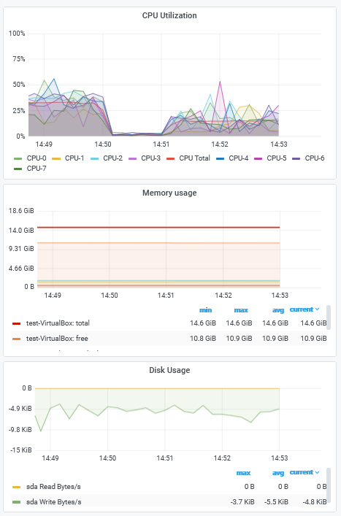
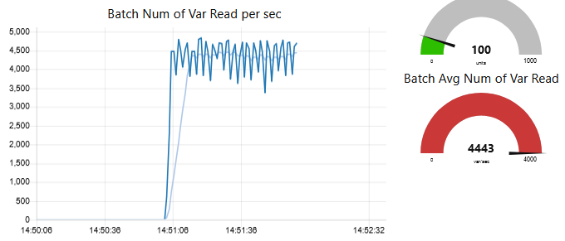
PACEdge Performance Indication (Node-RED OPC UA)
Test Server
RXi2-UP with PACEdge
DUT
RXi2-LP
RXi2-BP
CPL410/CPE400
IPC 2010
Node-RED Dashboard
Grafana Dashboard
Using single variable read operation:
  The client sends 100 single variable read requests
  The server responds with 100 replies
  Once all replies are received, the Client repeats the sequence.
Using batch read request:
  The client sends one read request containing 100 variables
  The server responds with 10 replies, each containing 10 variable updates
  Once all replies are received, the Client repeats the sequence
In addition to performing OPC UA read transactions, PACEdge is storing all variables in the InfluxDB database, uses one graph and one dial to show performance via the Node-RED dashboard and via the Grafana dashboard.
NOTE: Connext OPC UA performance is higher than Node-RED
OPC UA Client Functions | Units | LP (Rem) | BP (4-core) (Rem) | BP (4-core) (Loc & Rem) | CPL410/ CPE400 | IPC 2010
Test: OPC UA Single Var Read InfluxDB: Yes Node RED Dashboard: Yes Grafana Dashboard: Yes | Var/sec | 100 | 1000 | 1000 | 90 | 150
Test: OPC UA Batch Var Read InfluxDB: Yes Node RED Dashboard: Yes Grafana Dashboard: Yes | Var/sec | 450 | 3100 | 2900 | 350 | 450

Slide 24
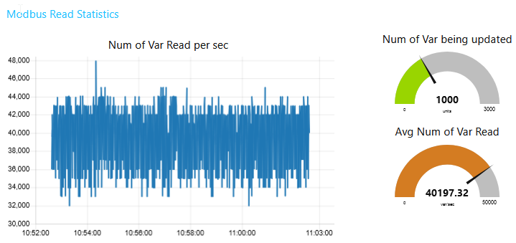
PACEdge Performance Indication (Modbus TCP)
Test Modbus TCP Client
RXi2-UP with PACEdge
DUT
RXi2-LP
RXi2-BP
CPL410/CPE400
Node-RED Dashboard
The PACEdge device with Modbus TCP (Server) is reading 1000 variables from Modbus TCP (Client).
The server issues 10 FC3 read requests for 100 variables each.
After all, responses are received, the read cycle is repeated.
All received variables are stored in InfluxDB, performance graph is displayed in Node-RED Dashboard,
IPC load is being captured via Telegraf and displayed via Grafana
Functions | Units | LP (Rem) | BP (4-core) (Rem) | BP (4-core) (Loc & Rem) | CPL410 (Rem) | IPC 2010
Modbus TCP Server InfluxDB Node-RED Dashboard Telegraf Grafana | Variable Read: (Var/sec) | 8K | 40K | 40K | 4K | 8K

Slide 25
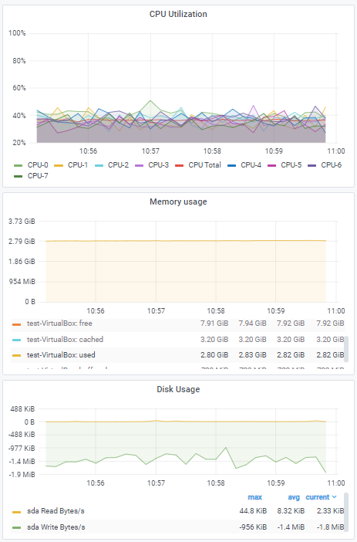
PACEdge Performance Indication (Connext Historian)
Test Modbus TCP Client
RXi2-UP with PACEdge
DUT
RXi2-LP
RXi2-BP
CPL410/CPE400
Grafana Dashboard
The PACEdge device uses the Modbus TCP Client driver within the Connext I/O data gateway to read variables
To store data via Historian inside the MySQL database.
The test is measuring how much data can Historian store in MySQL.
In parallel, Telegraf collects IPC load and Grafana displays it.
Client Functions | Parameter | LP (Rem) | BP_1605 (Rem) | BP_1605 (Loc & Rem) | CPL410 (Rem) | IPC 2010
Connext Modbus TCP driver MySQL Telegraf Grafana | Variable store rate: (Var/sec) | 50 | 750 | 750 | 50 | 50

Slide 26
PACEdge How To Guide

Slide 27
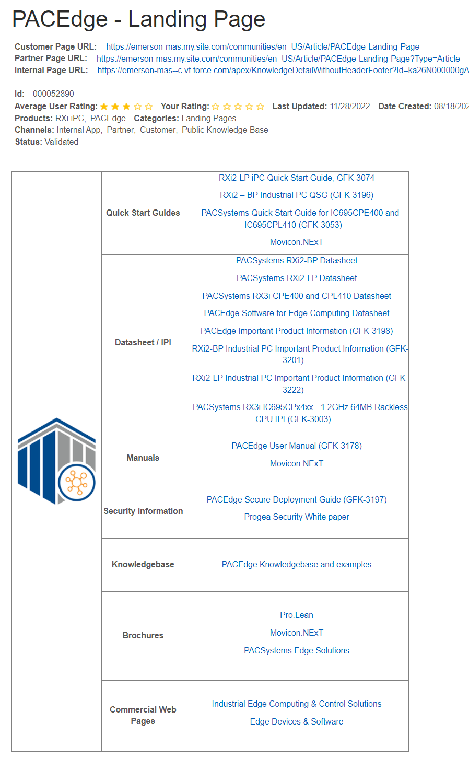
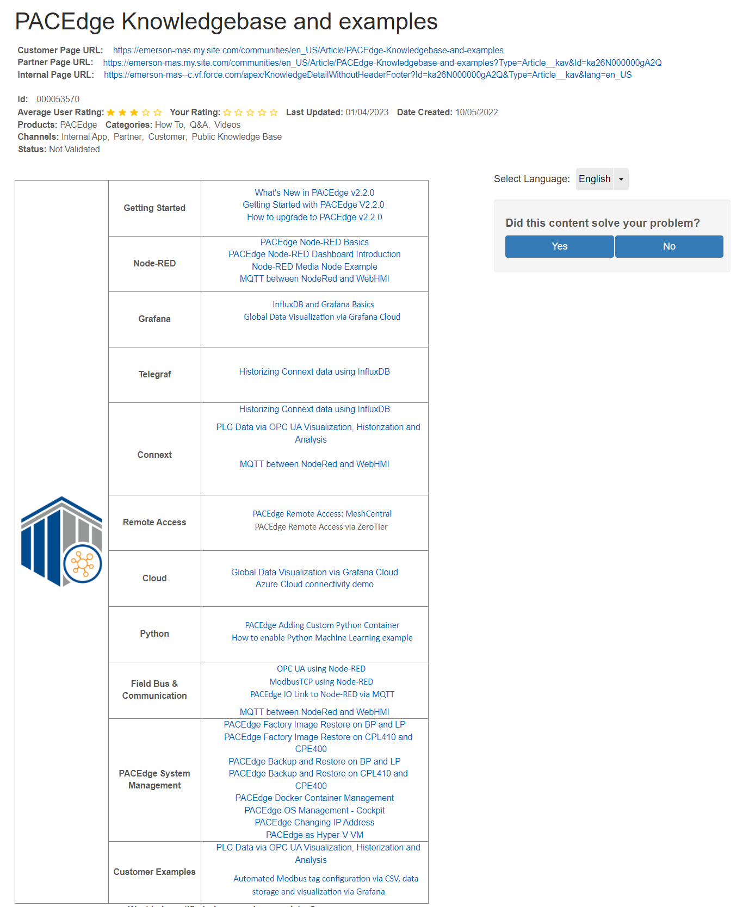
PACEdge Resources
PACEdge Landing Page at Sales Force site:
  Quick Start Guide
  User‘s Manual
  Important Product Information (IPI)
  Datasheet
  Secure Deployment Guide
PACEdge Knowledgebase and Examples:
  Lots of examples and how to guides, each with video and an associated technical files
  Includes:
    What is new in PACEdge v2.3.0
    Getting Started with PACEdge v2.3.0
    How to upgrade to PACEdge v2.3.0
    How to Backup/Restore/Recover PACEdge
    How to manage OS via Cockpit
    How to use main PACEdge applications, like Node-RED, Grafana, Connext, WebHMI
    How to move data to the Cloud

Slide 28
WEB Interface: Getting Started
Two Setup Cases: Headless (most common) and Direct (only using RXi2-BP)
Headless Setup:
  Via Ethernet, connect your PC to PACEdge ethernet port (consult Quick Start Guide or User Manual for details)
  Configure your PC IP address to be on 192.168.3.x subnet
  On your PC open any web browser, enter IP address: 192.168.3.100
  First, you will get a warning that device is using a self signed certificate. Click on Advanced and then on Accept and Continue.
  First time you connect, you will get a page with EULA and need to accept it
For details please consult: Getting Started PACEdge v2.3.0 Video in PACEdge Knowledgebase and Examples site on SFDC

Slide 29
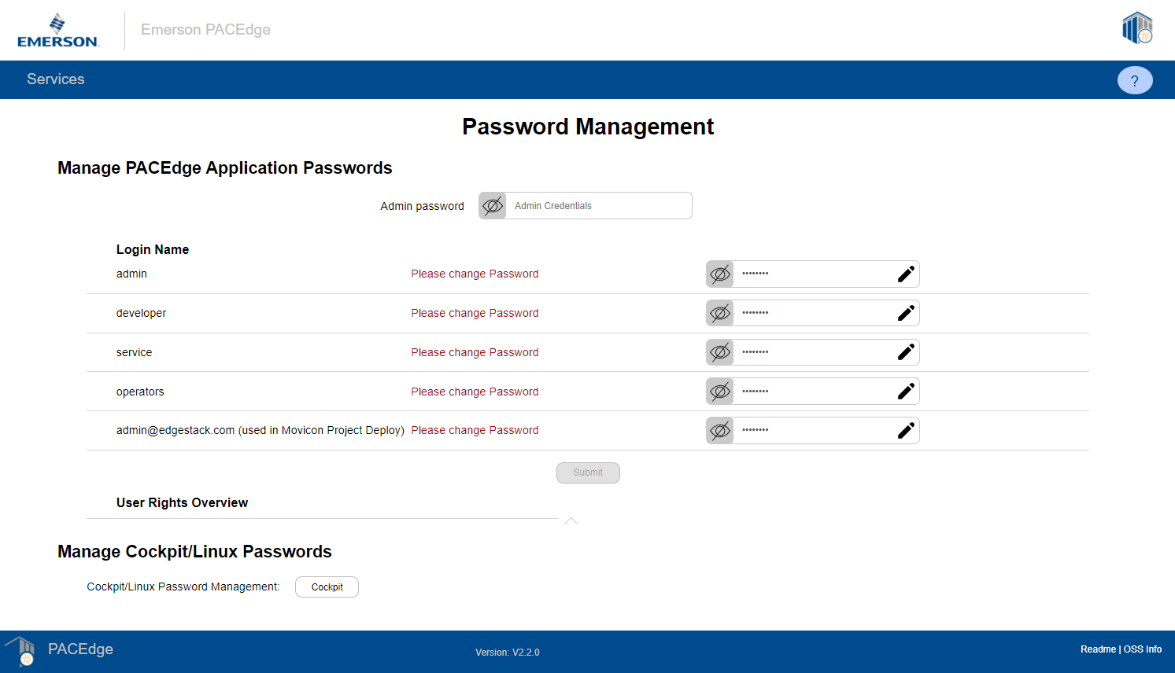
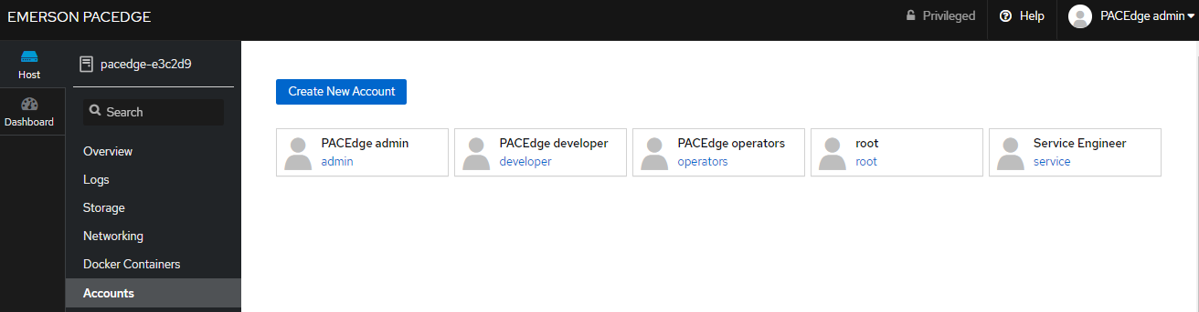
WEB Interface: Getting Started
Next, you will be guided to the password management page
There are two sets of independent passwords:
  PACEdge Applications
  PACEdge Linux Operating System (managed by Cockpit)
IMPORTANT: user MUST change default passwords, as this also sets up user accounts in some applications
Log-in using credentials:
  user: admin
  password: edgestack
PACEdge defines four user roles
(5th entry is credentials for Connext and WebHMI project deploy):
  admin
  developer
  service
  operators
Each role has different privileges and its own password
Given that password for each role needs to be changed in each PACEdge application, Password Management utility is designed to automate this task
First set passwords for PACEdge Applications, then use link to set Linux password via Cockpit graphical interface. You must set password for admin, but other users are optional.
Note: in Cockpit, do not set password for the root user as this will enable root access, which creates cyber security weakness
Restart PACEdge device
PACEdge Application Password Management
PACEdge Linux OS Password Management

Slide 30
PACEdge Landing Page
To get to the PACEdge Landing page you can either type in IP address into browser address field or click on the Emerson logo in the upper left corner
License status is shown at the top of the window
Depending on the SKU of the PACEdge, WebHMI link becomes only active once WebHMI project is uploaded via Movicon.NExT editor

Slide 31
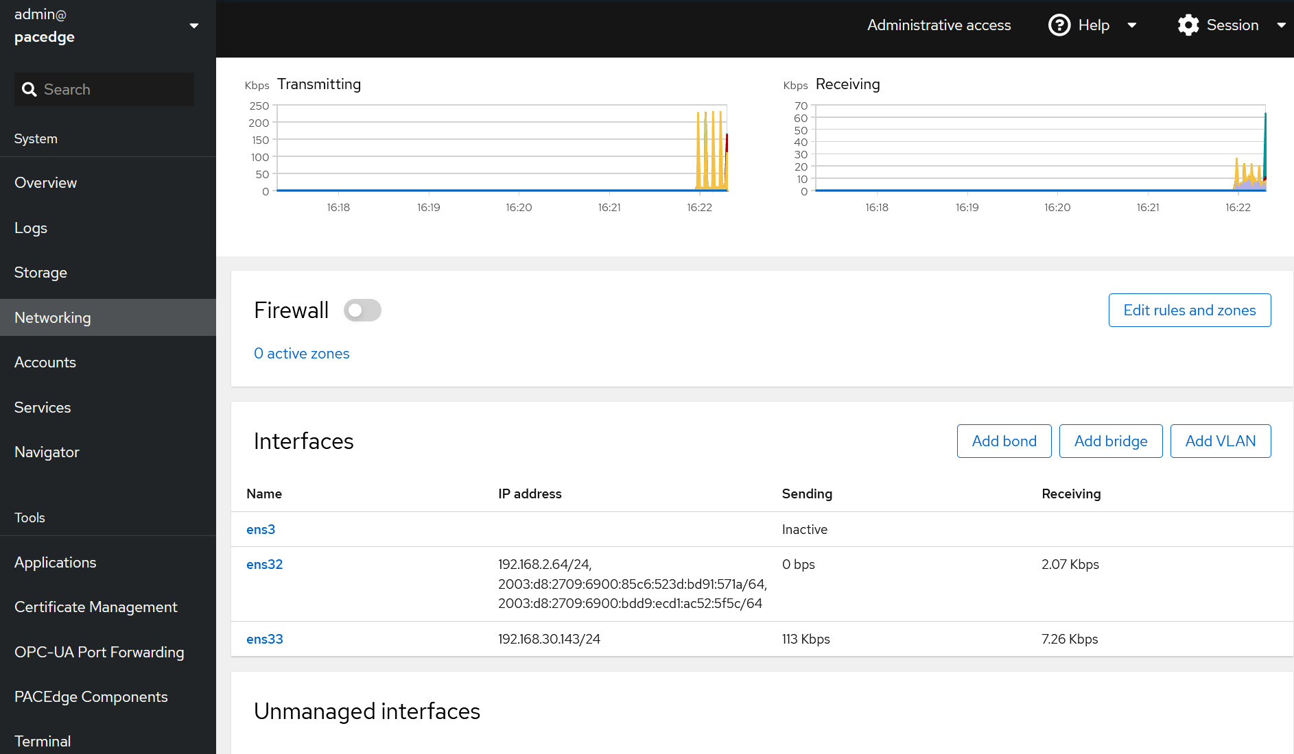
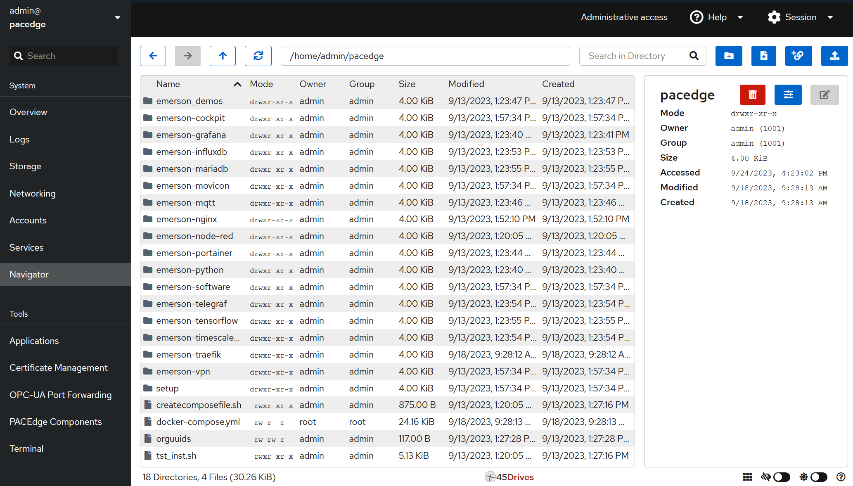
Cockpit: Linux Management Tool
Cockpit enables typical Operating System management tasks via the graphical user interface:
  Linux user/password management
  Resource (CPU, Memory, Storage, Network) monitoring
  Network Interface management (IP addresses, etc)
  File management (via Navigator)
  Log access
  Command line window
For more details: PACEdge OS Management – Cockpit (at PACEdge Knowledgebase & Examples SFDC site)

Slide 32
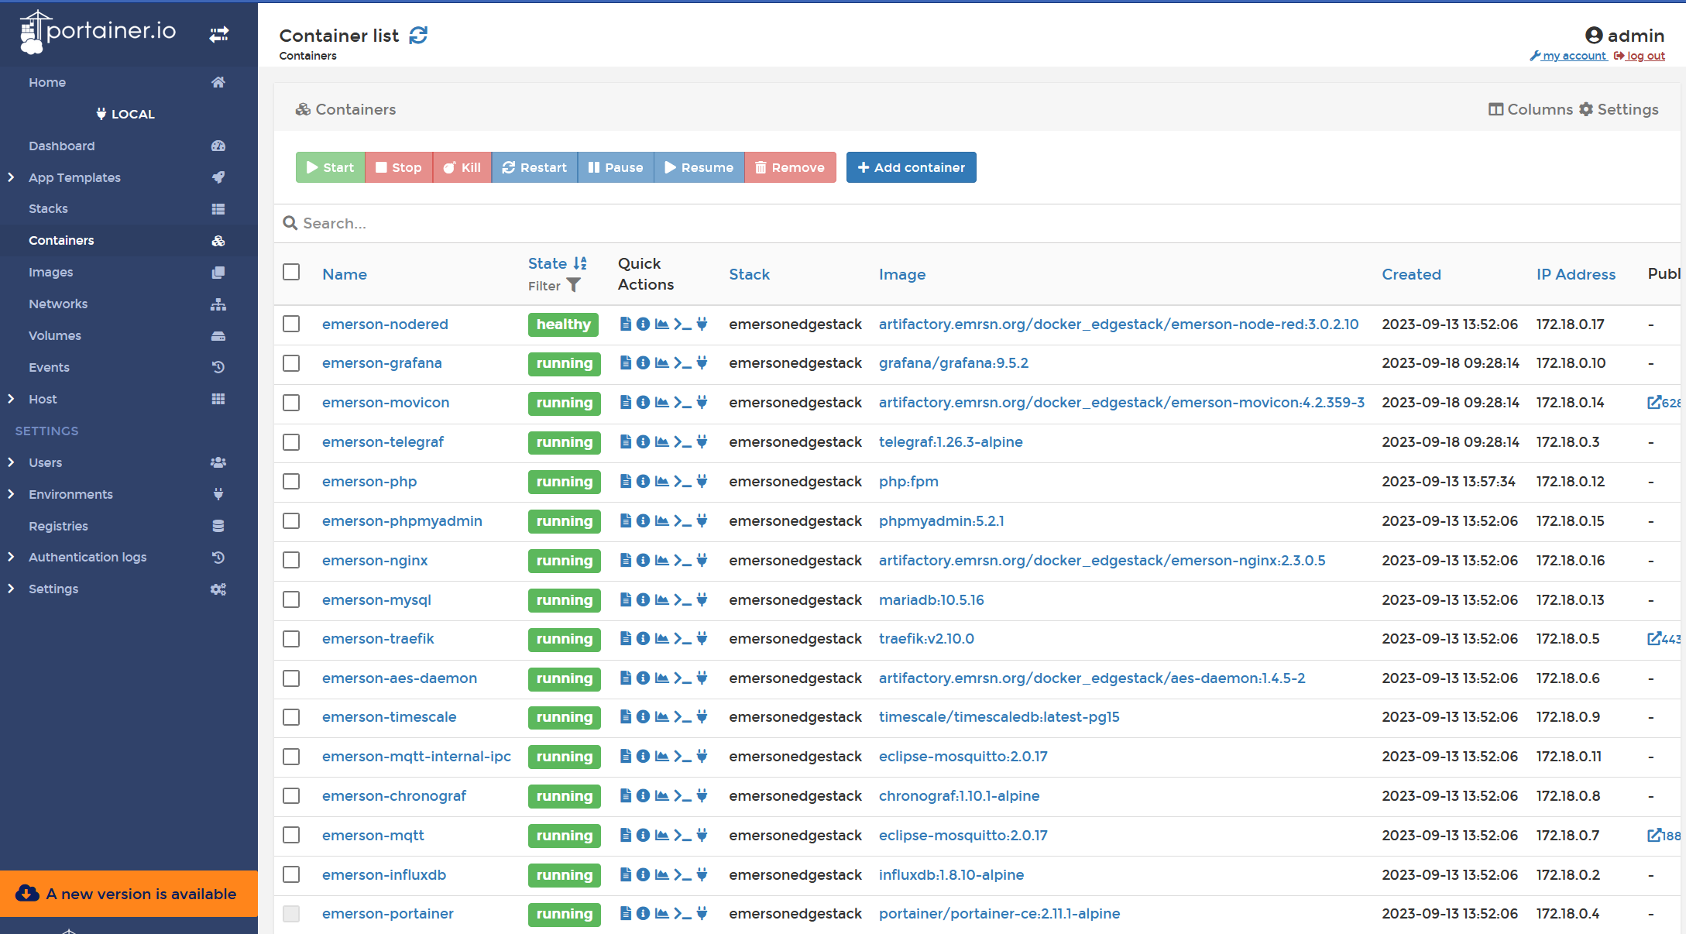
Portainer: Docker Container Management Tool
For more details: PACEdge Docker Container Management (at PACEdge Knowledgebase & Examples SFDC site)

Slide 33
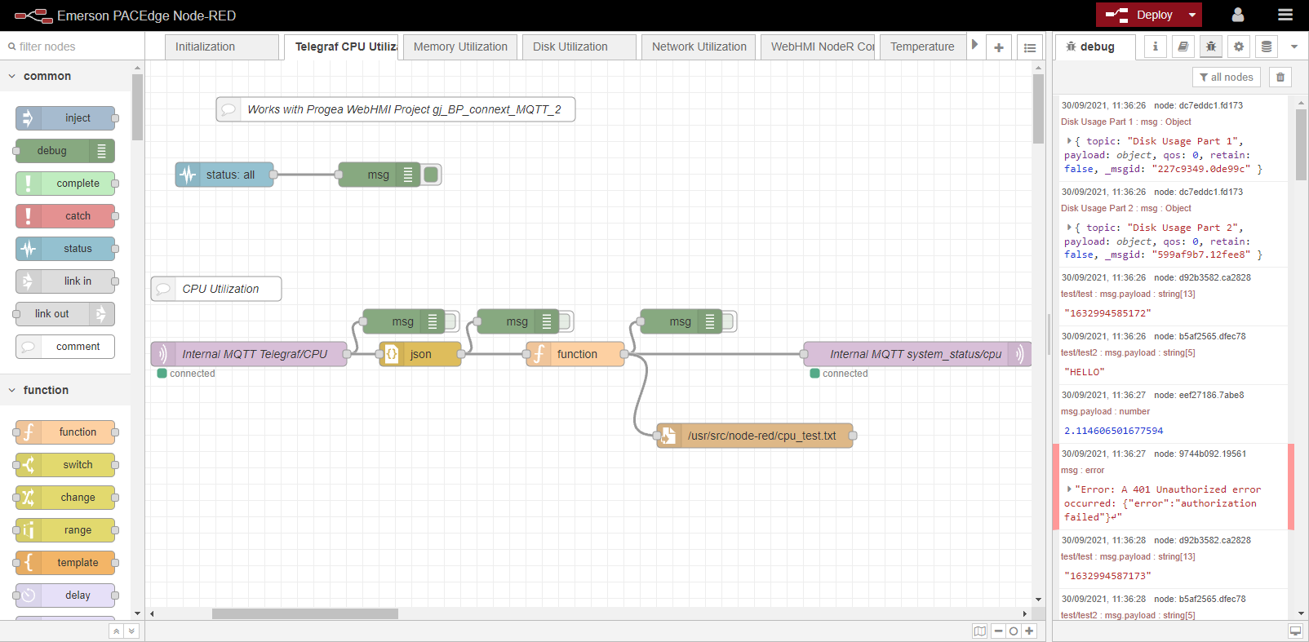
Node-RED: PACEdge Logic Engine
Node-RED application where main logic and control happens:
  Send/Receive data:
    MQTT
    OPC-UA
    Modbus TCP
    HTTP
    TCP/UDP
    Email
  Database In/Out:
    InfluxDB (time series database)
    MariaDB (MySQL) (relational database)
  Logic, Analytics, Math
  Dashboard for visualization
  Tons of 3rd party nodes
For introduction on how to use Nod-RED please use following resources:
  PACEdge Node-RED Basics video at PACEdge Knowledgebase and Examples SFDC site
  Use extensive on-line resources, for instance:
  https://nodered.org/docs/tutorials/
Node-RED can be started using a link on the landing page or link in the Cockpit or directly entering:
IP address/nodered/
Node-RED Dashboard, once created, can be accessed by adding /ui to the end: IP address/nodered/ui/

Slide 34
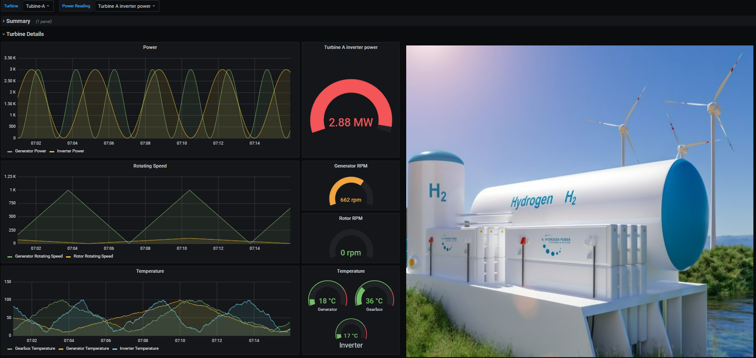
Grafana: Data Visulization, Analytics, Dashboarding
Grafana:
Browse and Visualize time series data
Perform database queries and data analytics
Create sophisticated dashboards
For more details: InfluxDB and Grafana Basics at PACEdge Knowledgebase and Examples SFDC site

Slide 35

Connext and WebHMI
Movicon.NExT
Windows PC
PACEdge IPC
WebHMI
Grafana
OPC UA Server
Node RED
I/O Data Server
MySQL
Develop Connext or WebHMI Project
Upload to PACEdge
Add, if required, Node-RED, Grafana, other components
More information: Connext examples and videos at PACEdge Knowledgebase and Examples SFDC site

Slide 36
PACEdge Licensing

Slide 37
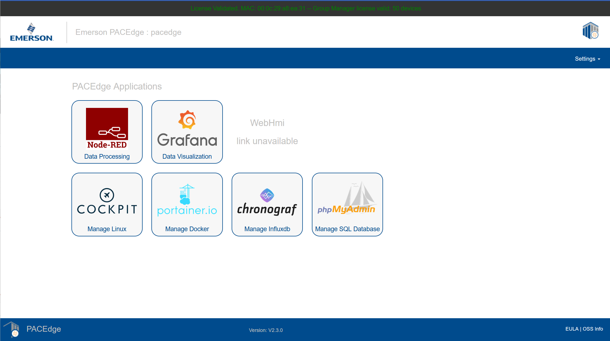

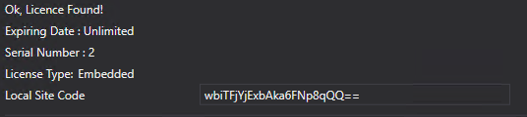
PACEdge 2.3.0 License Functionality
Depending on the PACEdge SKU, software license enables a specific set of functions:
  PACEdge Base functionality
  Base + Connext
  Base + WebHMI
  Group Manager and number of devices it can manage
PACEdge license status can be verified by getting to the PACEdge Home Page via browser. At the top of the window one of the two messages will be displayed:
Enabled Movicon features (Connext, WebHMI) can be checked via Movicon.NExT editor, using Deploy Project window, Remote License Info:
If license is invalid, PACEdge will be in the Demo mode, where full functionality is enabled for 60min and afterwards PACEdge will be disabled. After power cycling the unit, it will function again for 60min.

Slide 38
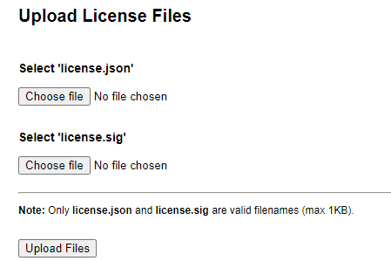
Installing License File
All PACEdge devices are being shipped with license installed and active.
If new license file is required, it can be obtained by contacting Customer Care and providing:
  MAC Address of the specific unit ( can be seen in the license status message)
  Serial number of the specific unit (can be found on the label)
Customer care will send you two files:
  license.json
  license.sig
To install the license, from PACEdge Home Page, go to Settings -> Upload License File and in the dialogue that opens, point to the two files that you have received:
Gracefully!! restart the PACEdge via Cockpit (do not pull the power, as files might not be stored yet on the file system)

Slide 39
Upgrading Older PACEdge to PACEdge v2.3.0
There are 3 ways to perform an upgrade:
Using newly introduced Group Manager functionality (requires one PACEdge device with Group Manager)
Using Cockpit->Navigator, handy for remote upgrades
Using USB Stick, convenient when disk space on device is limited or network bandwidth is restricted
Please consult PACEdge User Manual for step by step procedures

Slide 40
PACEdge Backup/Restore/Recover Functionality
PACEdge supports multiple ways to backup user data, such as Node-RED flows, Grafana dashboards, databases, whole PACEdge setup, etc
Backed up data can then be later restored on the same or other PACEdge device
If PACEdge software becomes misconfigured, user has an option to perform Recovery to Factory Default state
Please consult PACEdge User Manual for step by step procedures and PACEdge Knowledgebase and Examples SFDC site for example videos

Slide 41
New Features in PACEdge v2.3.0
PACEdge Technical Architecture

Slide 42
PACEdge Application Updates
Component | Version Number
PACEdge | 2.3.0
Movicon.NExT Editor Support | 4.2
Containers | Version Number
MQTT | 2.0.17
MySQL (Mariadb) | 10.5.16
Node-RED | 3.0.2.9
InfluxDB | 1.8.10
Chronograf | 1.10.1
Grafana | 9.5.2
Portainer | 2.11.1
NGINX | 2.3.0.5
Traefik | 2.10.0
Telegraf | 1.26.3
TimescaleDB | 2.11.1
phpMyAdmin | 5.2.1
Connext/WebHMI | 4.2.359

Slide 43
New Feature
PACEdge Group Manager

Slide 44

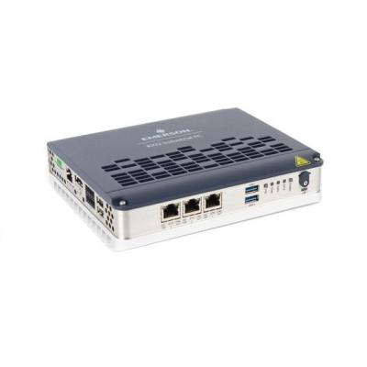



Basic Group Management
Introducing Basic Group Management functionality:
  Update Linux OS
  Update PACEge Applications (containers)
  Update Node-RED flows
Device sub-grouping (Site) option
Automatically update many PACEdge devices within your network
Command line interface, GUI coming soon
Group Manager available on RXi2-BP, managing:
  10 Devices
  50 Devices
  100 Devices
Customer Plant
PACEdge
Group Manager
Customer Intra-Net
PACEdge Site
(Pipeline North)
PACEdge Site
(Pipeline South)
PACEdge Site
(Plant Alpha)

Slide 45
How to use Group Manager
Configure Group Manager
Provision devices to be managed by the Group Manager and setup multiple groups as needed
Execute one or more “playbooks” to perform desired operation on the group of devices
Currently available playbooks:
  Upgrade PACEdge v2.2.x to PACEdge v2.3.0
    For more details consult: PACEdge v2.3.0 User Manual, section 9.1
  Update Node-RED flow
    For more details consult: PACEdge v2.3.0 User Manual, section 4.5

Slide 46
New Feature
PACEdge Certificate Management

Slide 47
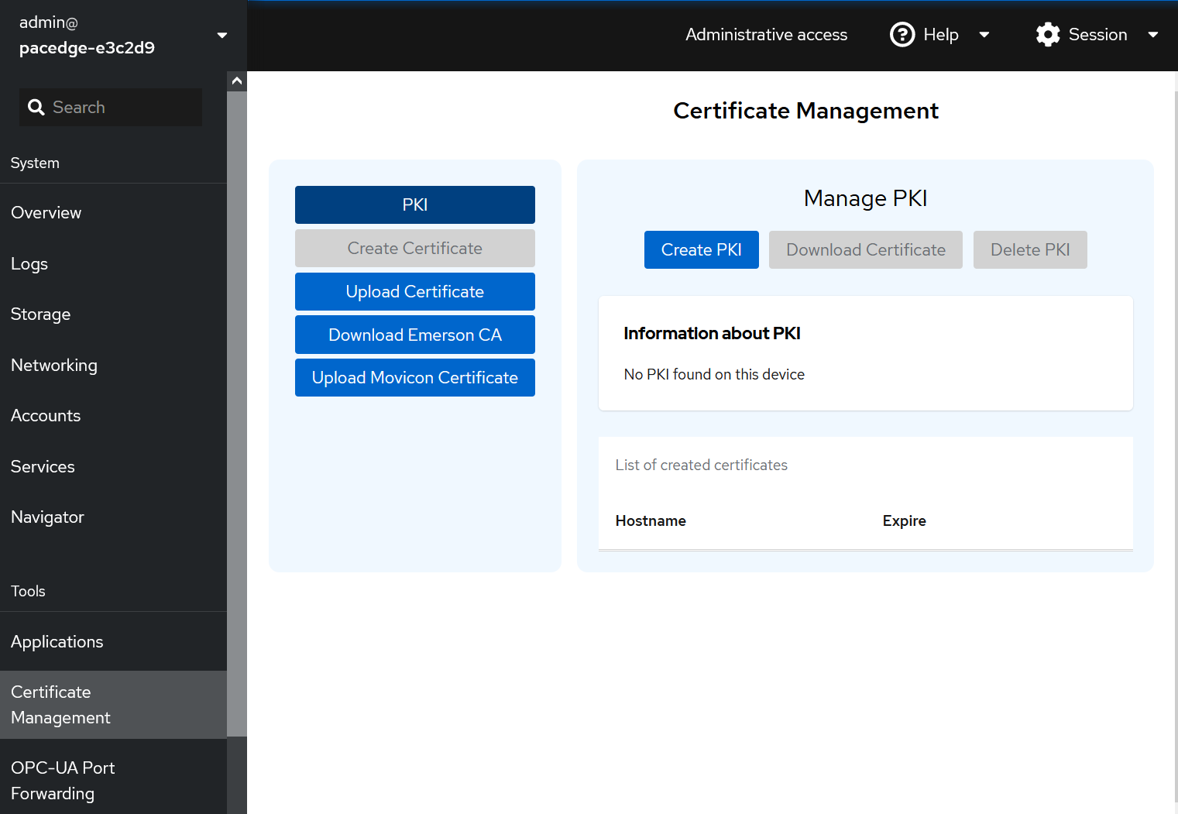
Certificate Management Utility
Certificates in PACEdge are used for:
  encrypting communications
  preventing Man-In-The-Middle attacks
  ensuring that remote device is indeed a PACEdge device
Out of the factory, PACEdge v2.3.0 comes with pre-installed PACEdge Certificate
  Once user adds PACEdge CA certificate to the browser‘s trusted CA list, all PACEdge v2.3.0 device certificates are deemed trusted
In addition, PACEdge v2.3.0 comes with Certificate Management Services (accessible through Cockpit):
  Uploading/Downloading certificates
  Creating own PKI and issuing own certificates for other devices
  Uploading certificates (such as OPC-UA) to Movicon container
It is recommended that user either sets up his own PKI (using PACEdge Certificate Management Utility) or uses his already existing PKI
For more details: consult PACEdge v2.3 User’s Manual section 4.6 and PACEdge v2.3 Secure Deployment Guide
PACEdge CA
User’s own CA,
using PACEdge Certificate Management utility.
User’s own CA
PACEdge Device certificate

Slide 48
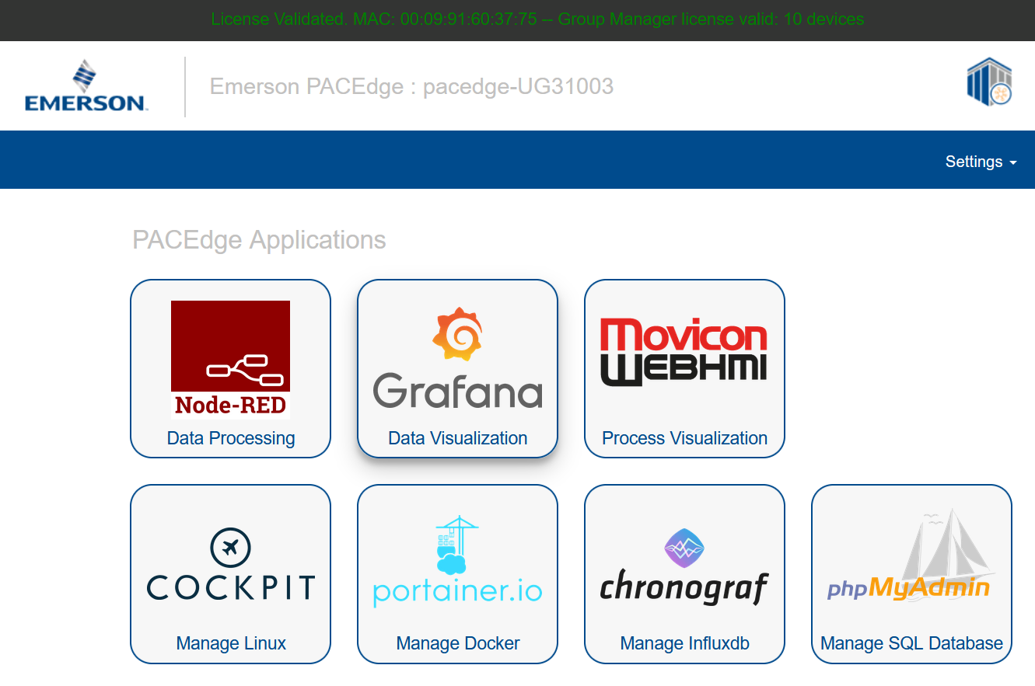
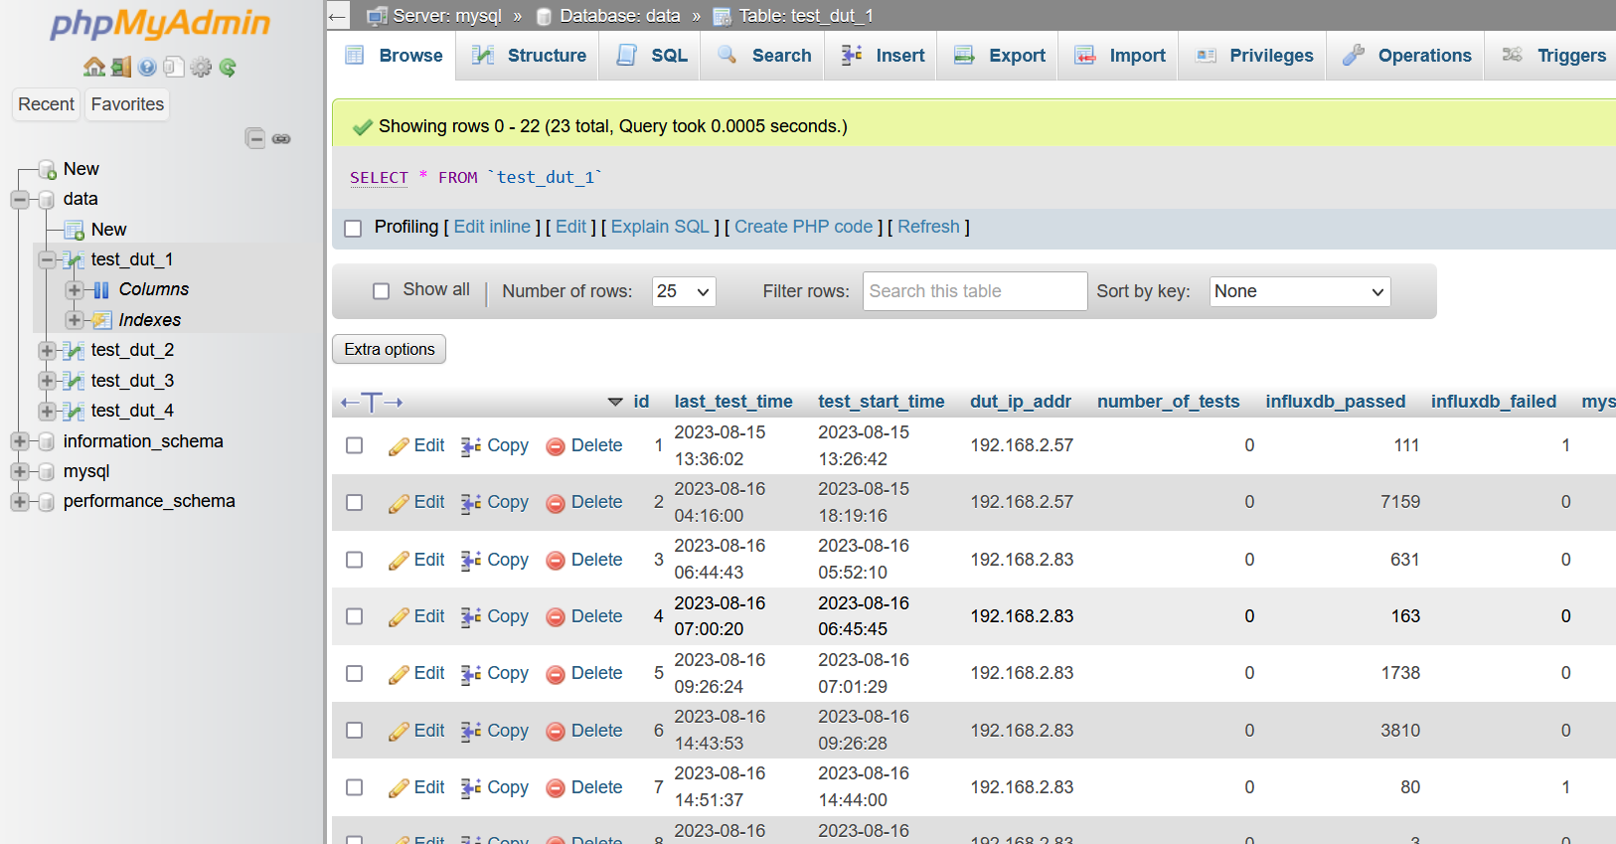
MySQL Management Tool phpMyAdmin
phpMyAdmin tool, accessible from PACEdge landing page
Allows to graphically view and manage MySQL database

Slide 49


TimescaleDB Database
TimescaleDB is a PostgreSQL database, extended for time series data.
It supports SQL queries and can be used for both, relational and time series data.
It is performance optimized for time series data and significantly outperforms MySQL
Node-RED has a pre-installed Postgresql node, that can be used to access TimescaleDB
Use examples will follow

Slide 50
An Optional Python Container & Example
PACEdge v2.3.0 contains an optional Python container
  When enabled, it installs Python container with example application (requires Internet access), example demonstrates:
    how to use OPC-UA Clients, in both Node-RED and Python
    how to use Node-REDs nodes to trigger Python scripts on variety of conditions
    how to send commands from Node-RED to Python
    how to send results from Python to Node-RED
    how to store data in database
  Detailed example, Node-RED flows, video files are all available from PACEdge Knowledgebase site
Node-RED
OPC-UA
Simulator
Dashboard
OPC-UA
Client
Trigger Conditions
MQTT
Client
Python
MQTT
Client
OPC-UA
Client
User Script 1
Dispatcher
User Script 2

Slide 51
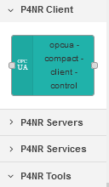
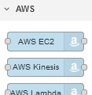


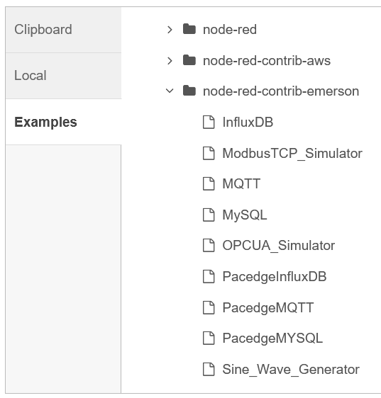
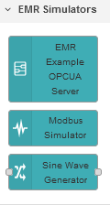
Node-RED Improvements
Upgraded Node-RED to a newer version: v3.0.2.9
Added new and improved OPC-UA node palette from Plus for Node-RED (P4NR)
Added Azure and AWS Cloud nodes, examples are available in PACEdge Knowledgebase
Created three data Simulators:
  Sine Wave generator
  ModbusTCP Device simulator
  OPC-UA Server simulator
  Simulators with example flows are installable via Node-RED->Import->Examples->node-red-contrib-emerson

